Slide 1
Generalized Linear Models

Slide 2
Generalized Linear Models (GLM)
General class of linear models that are made up of 3 components: Random, Systematic, and Link Function
Random component: Identifies dependent variable (Y) and its probability distribution
Systematic Component: Identifies the set of explanatory variables (X₁,...,X_{k})
Link Function: Identifies a function of the mean that is a linear function of the explanatory variables

Slide 3
Random Component
Conditionally Normally distributed response with constant standard deviation - Regression models we have fit so far.
Binary outcomes (Success or Failure)- Random component has Binomial distribution and model is called Logistic Regression.
Count data (number of events in fixed area and/or length of time)- Random component has Poisson distribution and model is called Poisson Regression
When Count data have V(Y) > E(Y), model fit can be Negative Binomial Regression
Continuous data with skewed distribution and variation that increases with the mean can be modeled with a Gamma distribution

Slide 4
Common Link Functions
Identity link (form used in normal and gamma regression models):
Log link (used when μ cannot be negative as when data are Poisson counts):
Logit link (used when μ is bounded between 0 and 1 as when data are binary):

Slide 5
Logistic Regression
Logistic Regression - Dichotomous Response variable and numeric and/or categorical explanatory variable(s)
Goal: Model the probability of a particular outcome as a function of the predictor variable(s)
Problem: Probabilities are bounded between 0 and 1
Distribution of Responses: Binomial
Link Function:

Slide 6
Logistic Regression with 1 Predictor
Response - Presence/Absence of characteristic
Predictor - Numeric variable observed for each case
Model - π(x) ≡ Probability of presence at predictor level x
β₁ = 0 ⇒ P(Presence) is the same at each level of x
β₁ > 0 ⇒ P(Presence) increases as x increases
β ₁< 0 ⇒ P(Presence) decreases as x increases

Slide 7
Logistic Regression with 1 Predictor
β₀, β₁ are unknown parameters and must be estimated using statistical software such as SPSS, SAS, R or STATA (or in a matrix language)
Primary interest in estimating and testing hypotheses regarding β₁
Large-Sample test (Wald Test):
H₀: β₁ = 0 H_{A}: β₁ ≠ 0
Note: Some software packages perform this as an equivalent Z-test or t-test

Slide 8
Odds Ratio
Interpretation of Regression Coefficient (β):
In linear regression, the slope coefficient is the change in the mean response as x increases by 1 unit
In logistic regression, we can show that:
Thus e^{β} represents the change in the odds of the outcome (multiplicatively) by increasing x by 1 unit
If β = 0, the odds and probability are the same at all x levels (e^{β}=1)
If β > 0 , the odds and probability increase as x increases (e^{β}>1)
If β < 0 , the odds and probability decrease as x increases (e^{β}<1)

Slide 9
95% Confidence Interval for Odds Ratio
Step 1: Construct a 95% CI for β :
Step 2: Raise e = 2.718 to the lower and upper bounds of the CI:
If entire interval is above 1, conclude positive association
If entire interval is below 1, conclude negative association
If interval contains 1, cannot conclude there is an association

Slide 10
Multiple Logistic Regression
Extension to more than one predictor variable (either numeric or dummy variables).
With k predictors, the model is written:
Adjusted Odds ratio for raising x_{i} by 1 unit, holding all other predictors constant:
Many models have nominal/ordinal predictors, and widely make use of dummy variables

Slide 11
Testing Regression Coefficients
Testing the overall model:
L₀, L₁ are values of the maximized likelihood function, computed by statistical software packages. This logic can also be used to compare full and reduced models based on subsets of predictors. Testing for individual terms is done as in model with a single predictor.

Slide 12
Poisson Regression
Generally used to model Count data
Distribution: Poisson (Restriction: E(Y)=V(Y))
Link Function: Can be identity link, but typically use the log link:
Tests are conducted as in Logistic regression
When the mean and variance are not equal (over-dispersion), often replace the Poisson Distribution replaced with Negative Binomial Distribution

Slide 13
Multilevel Regression Model
Known in literature under a variety of names
Hierarchical linear model (HLM)
Random coefficient model
Variance component model
Multilevel model
Contextual analysis
Mixed Linear Model

Slide 14
Hierarchical Data Structure
Three level data structure
Groups at different levels may have different sizes
Response (outcome) variable at lowest level
Explanatory variables at all levels

Slide 15
Traditional Approaches
Disaggregate all variables to the lowest level
Do standard analyses (anova, multiple regression)
Aggregate all variables to the highest level
Do standard analyses (anova, multiple regression)
Ancova with groups as factor
Some improvements:
explanatory variables as deviations from their group mean have both deviation score and disaggregated group mean as predictor (separates individual and group effects)
Why not? What is wrong with this?

Slide 16
Problems With Standard Analysis of Hierarchical Data
Multiple Regression assumes
independent observations
independent error terms
equal variances of errors for all observations
(assumption of homoscedastic errors)
normal distribution for errors
With hierarchical data
observations are not independent
errors are not independent
different observations may have errors with different variances (heteroscedastic errors)

Slide 17
Problems With Standard Analysis of Hierarchical Data
Observations in the same group are generally not independent
they tend to be more similar than observations from different groups
selection, shared history, contextual group effects
The degree of similarity is indicated by the intraclass correlation rho: ρ
Standard statistical tests are not at all robust against violation of the independence assumption

Slide 18
Graphical Picture of Simple Two-level Regression Model
School level
Pupil level
Outcome variable on pupil level
Explanatory variables at both levels: individual & group
Residual error at individual level
Plus residual error at school level

Slide 19
Regression analysis
In ordinary regression, with one explanatory variable X:
Y_{i}= β₀+ β₁X_{i}+ e_{i}
β₀ intercept,
β₁ regression slope,
e_{i} residual error term

Slide 20
Regression analysis

Slide 21
Building the Multilevel Regression Model: Random intercept model
In multilevel regression, at the lowest level:
Y_{ij}= β_{0j}+ β_{1j}X_{ij}+ e_{ij}
β_{0j} intercept,
β_{1j} regression slope,
e_{ij} residual error term
subscript i for individuals, j for groups
each group has its own intercept coefficient β_{0j}
and its own slope coefficient β_{1j}

Slide 22
Building the Multilevel Regression Model: Intercept only model
In multilevel regression, at the lowest level:
Y_{ij}= β_{0j}+ e_{ij}
Random intercept model:
β_{0j}= γ₀₀+ u_{0j}
γ₀₀ is the intercept of β_{0j} u_{0j} is the residual error term in the equation for β_{0j}

Slide 23
Building the Multilevel Regression Model: Random intercept model
In multilevel regression, at the lowest level:
Y_{ij}= β_{0j}+ β_{1j}X_{ij}+ e_{ij}
Random intercept model:
β_{0j}= γ₀₀+ u_{0j}
γ₀₀ is the intercept of β_{0j} u_{0j} is the residual error term in the equation for β_{0j}

Slide 24
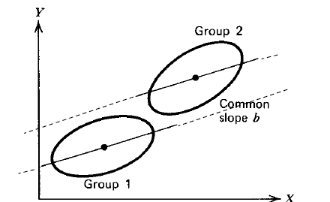
Building the Multilevel Regression Model: Random intercept model

Slide 25
Building the Multilevel Regression Model: Intercept only model
Y_{ij}= β_{0j}+ β_{1j}X_{ij}+ e_{ij}
Random intercept model:
β_{0j}= γ₀₀+ u_{0j}
γ₀₀ is the intercept of β_{0j} u_{0j} is the residual error term in the equation for β_{0j}
Random slope model:
β_{1j}= γ₁₀+ u_{1j}
γ₁₀ is the intercept of ß_{1j}
u_{1j} is the residual error term in the equation for β_{1j}

Slide 26
Difference with the usual regression model:
Each class has a different intercept coefficient b0j and a different slope coefficient b1j
Since the intercept and the slope coefficients vary across the classes: random coefficients
=> Random intercept model & random slope model

Slide 27
Building the Multilevel Regression Model: Random slope model

Slide 28
Building the Multilevel Regression Model: the Second (Group) Level
Next step:
explain the variation of the regression coefficients b0j and b1j by introducing explanatory variables at the class level

Slide 29
Building the Multilevel Regression Model: the Second (Group) Level
At the lowest (individual) level we have
Y_{ij}= β_{0j}+ β_{1j}X_{ij}+ e_{ij}
β_{0j}= γ₀₀+ γ₀₁Z_{j}+ u_{0j}
γ₀₀ and γ₀₁ are the intercept and slope to predict β_{0j} from Z_{j}
u_{0j} is the residual error term in the equation for β_{0j}

Slide 30
Building the Multilevel Regression Model: Cross level interaction
At the lowest (individual) level we have
Y_{ij}= β_{0j}+ β_{1j}X_{ij}+ e_{ij}
β_{0j}= γ₀₀+ γ₀₁Z_{j}+ u_{0j}
γ₀₀ and γ₀₁ are the intercept and slope to predict β_{0j} from Z_{j}
u_{0j} is the residual error term in the equation for β_{0j}
β_{1j}= γ₁₀+ γ₁₁Z_{j}+ u_{1j}
γ₁₀ and γ₁₁ are the intercept and slope to predict ß_{1j} from Z_{j}
u_{1j} is the residual error term in the equation for β_{1j}

Slide 31
Building the Multilevel Regression Model: Single Equation Version
At the lowest (individual) level we have
Y_{ij}= β_{0j}+ β_{1j}X_{ij}+ e_{ij}
and at the second (group) level
β_{0j}= γ₀₀+ γ₀₁Z_{j}+ u_{0j}
β_{1j}= γ₁₀+ γ₁₁Z_{j}+ u_{1j}
Combining (substitution and rearranging terms) gives
Y_{ij}= γ₀₀+ γ₁₀X_{ij}+ γ₀₁Z_{j}+ γ₁₁Z_{j}X_{ij}+ u_{1j}X_{ij}+ u_{0j}+ e_{ij}

Slide 32
Building the Multilevel Regression Model: Single Equation Version
Y_{ij}= [γ₀₀+ γ₁₀X_{ij}+ γ₀₁Z_{j}+ γ₁₁Z_{j}X_{ij}] + [u_{1j}X_{ij}+ u_{0j}+ e_{ij}]
This equation has two distinct parts
[γ₀₀+ γ₁₀X_{ij}+ γ₀₁Z_{j}+ γ₁₁Z_{j}X_{ij}] contains all the fixed coefficients, it is called the fixed part of the model
[u_{1j}X_{ij}+ u_{0j}+ e_{ij}] contains all the random error terms, it is called the random part of the model

Slide 33
Building the Multilevel Regression Model: Interpretation
Y_{ij} = [γ₀₀+ γ₁₀X_{ij}+ γ₀₁Z_{j}+ γ₁₁Z_{j}X_{ij}] + [u_{1j}X_{ij}+ u_{0j}+ e_{ij}]
Several error variances
σ_{e}² variance of the lowest level errors e_{ij}
σ²_{u0} variance of the highest level errors u_{0j}
σ²_{u1} variance of the highest level errors u_{1j}
σ_{u01} covariance of u_{0j} and u_{1j}

Slide 34
Full Multilevel Regression Model
Explanatory variables at all levels
Higher level variables predict variation of lowest level intercept and slopes
Predicting the intercept implies a direct effect
Predicting slopes implies cross-level interactions

Slide 35
Model Exploration
1 Intercept-only model
calculate intraclass correlation
2 Fixed model, 1st level predictor variables
test individual slopes for significance
3 Model intercept by 2nd level predictor variables
test for significance, how much intercept variance explained?
4 Random coefficient model
test if any 1st level slope has a significant variance component (this is best done one-by-one)
5 Model random slopes by higher level variables: cross level interactions
test for significance, how much slope variance is explained?
Notes:
Note: sometimes it is interesting to calculate the intraclass correlation for all variables!

Slide 36
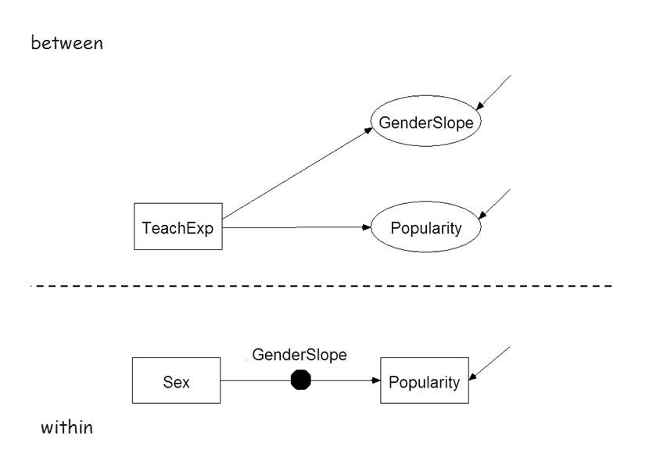
Graphical Picture of Simple Two-level Regression Model

Slide 37
BAYESIAN INFERENCE

Slide 38
Bayesian inference: Scheme
1) Model to describe data:
Unknown parameters about which we want to make inferences from observed data
parameter(s) of interest
Usually:
nuisance parameter(s)
2) Full Model:
“Prior density” for the parameters
3) Get distribution of unknown parameters conditioned to observed data:
Bayes Theorem (Bayes “rule”)

Slide 39
4) Draw inferences on parameters of interest from “posterior” densities:
Integrate on nuisance parameters:
…if any, for otherwise simpler expression:
… may get conditional densities if needed:
Normalisation:
and usually, domain does not depend on parameters so

Slide 40
5) Bayesian approach allows, eventually, to make “predictive inferences” (… model checking)
Within same model predict new data yet to come
sampling independent
related through

Slide 41
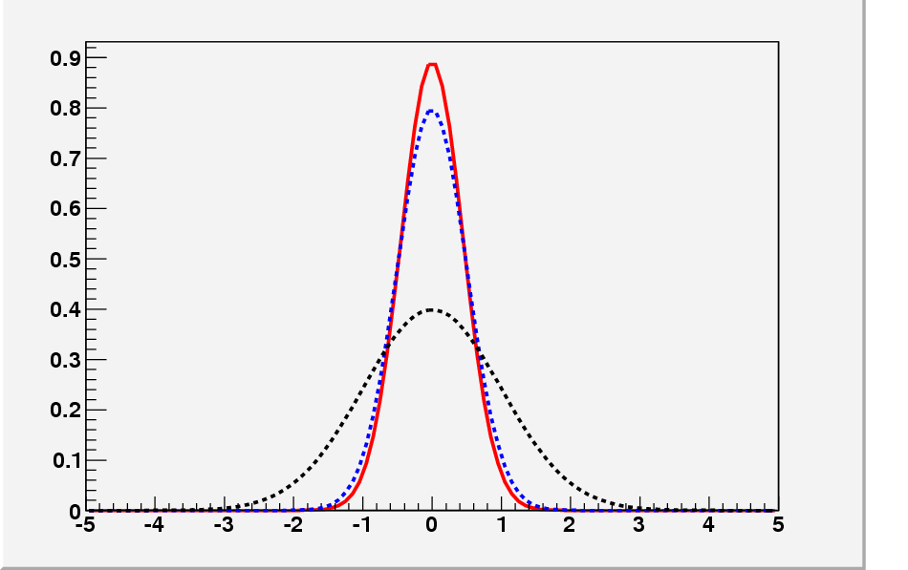
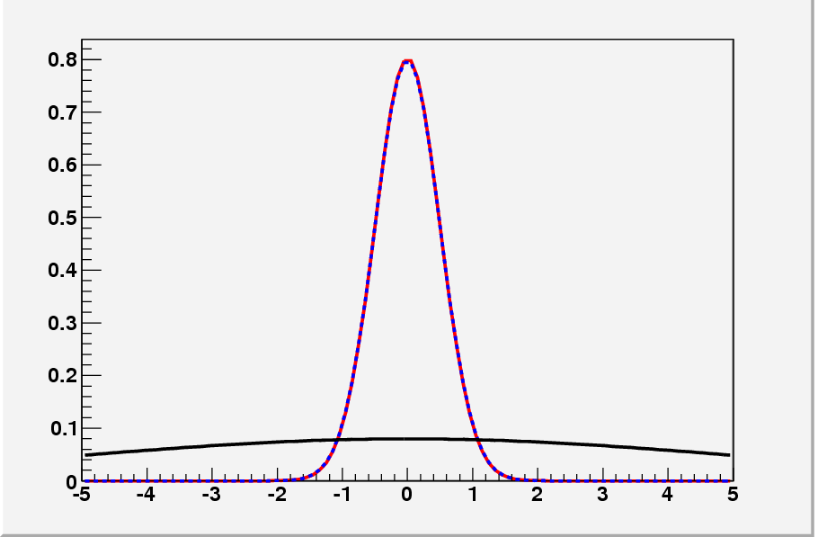
Bayesian inference: Elements
Likelihood: How data modifies our knowledge on the parameters
Experiment affect knowledge on parameters only through likelihood
(thus, same likelihoods→ same inferences)
Defined up to a multiplicative constant
Prior: Knowledge (“degree of credibility”) about parameters before data is taken
Informative: Include Prior knowledge (in particular, if trustable info from previous experiments)
Non-Informative: Relative ignorance before experiment is done (… independent experiment)
… posterior is dominated by likelihood
posterior
posterior
likelihood
likelihood
prior
prior

Slide 42
Bayesian inference: Structures
One experiment (same conditions)
Results from isolated experiments ( independent)
Parameters come from a common source governed by hyperparameters

Slide 43
EXAMPLE:
Acceptance of events after cuts (or efficiency or whatever)
Total number of events N
Number of events that have been observed to pass the cuts n
Model:
(B: OK… “a” model)
Frequentist / Classical Solution:
“Estimator” of θ: (maximizing the likelihood)
(B: How
Why)
θ* is a random quantity with:
(B: So what?)
…e(k>>)…
(B: ?)
(B: did you e(k)?)
(B: inferences(e(k)) ?)
(B: if n=0, n=N?)
Confidence Level Interval:
(B: What does it mean?)
(B: Does it contain ?)

Slide 44
Bayes Solution:
Bayes “rule”:
(F: θ is a fixed (albeit unknown) number. Can’t talk about probabilities…
Prior density:
B: Probability is… + Ramsey, de Finetti, Savage, Lindley, …)
Bayes-Laplace postulate (“Principle of Insufficient Reason”) If no special reason, all possible outcomes are equally likely
Posterior density:
(F: Inferences depend
on π(θ) ?
Inferences on θ :
(F: Is biased ?
B: So what? n=0,n=N)

Slide 45
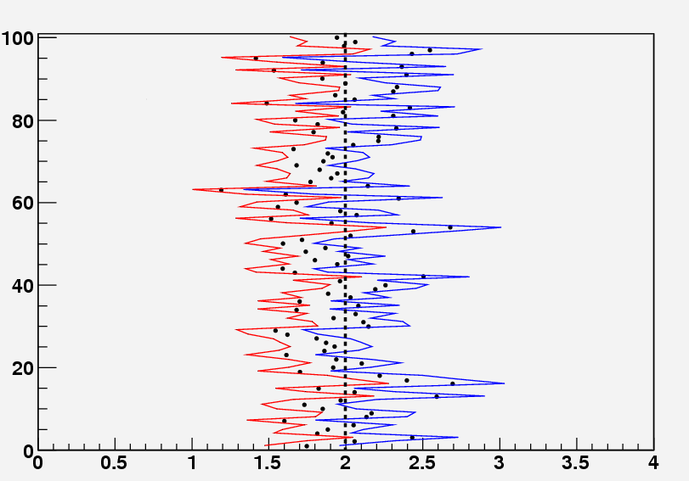
EXAMPLE:
Frequentist / Classical Solution:
Maximum likelihood:
100 identical experiments
…random intervals
Absolutely different philosophy:
Frequentist: Given the parameters, how likely is the observed sample?,…
Great but of hardly any interest;… we are interested in the parameters
Bayesian: Given the data, draw inferences on the parameters,…
34 do not contain
…you do one sampling (n=50)…

Slide 46
In the Bayesian Solution for the Binomial example, we took a uniform prior density:
Bayes-Laplace postulate (“Principle of Insufficient Reason”; J. Bernoulli) If no special reason, all possible outcomes are equally likely
Not always reasonable choice
2) Consistency: Non-linear one-to-one transformation
Ex:
Task: Reasonable and sound criteria to choose a proper prior density:
Several arguments:
Invariances
Conjugated Priors
Probability Matching Priors
Reference Priors
Hierarchical Structures
… more…
(Jeffreys (1939))
(Raiffa+Schlaifer (1961))
(Welch+Peers (1963) … Ghosh, Datta, Mukerjee,…)
(Bernardo (1979), Berger)

